Slide 1


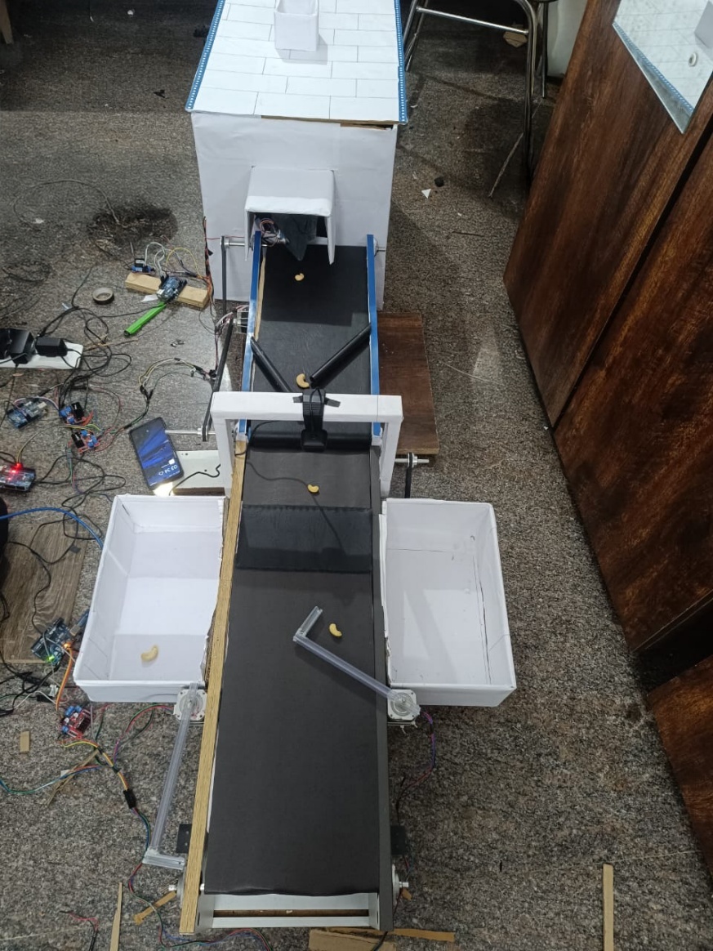
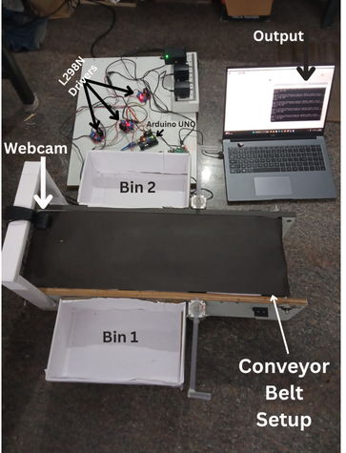
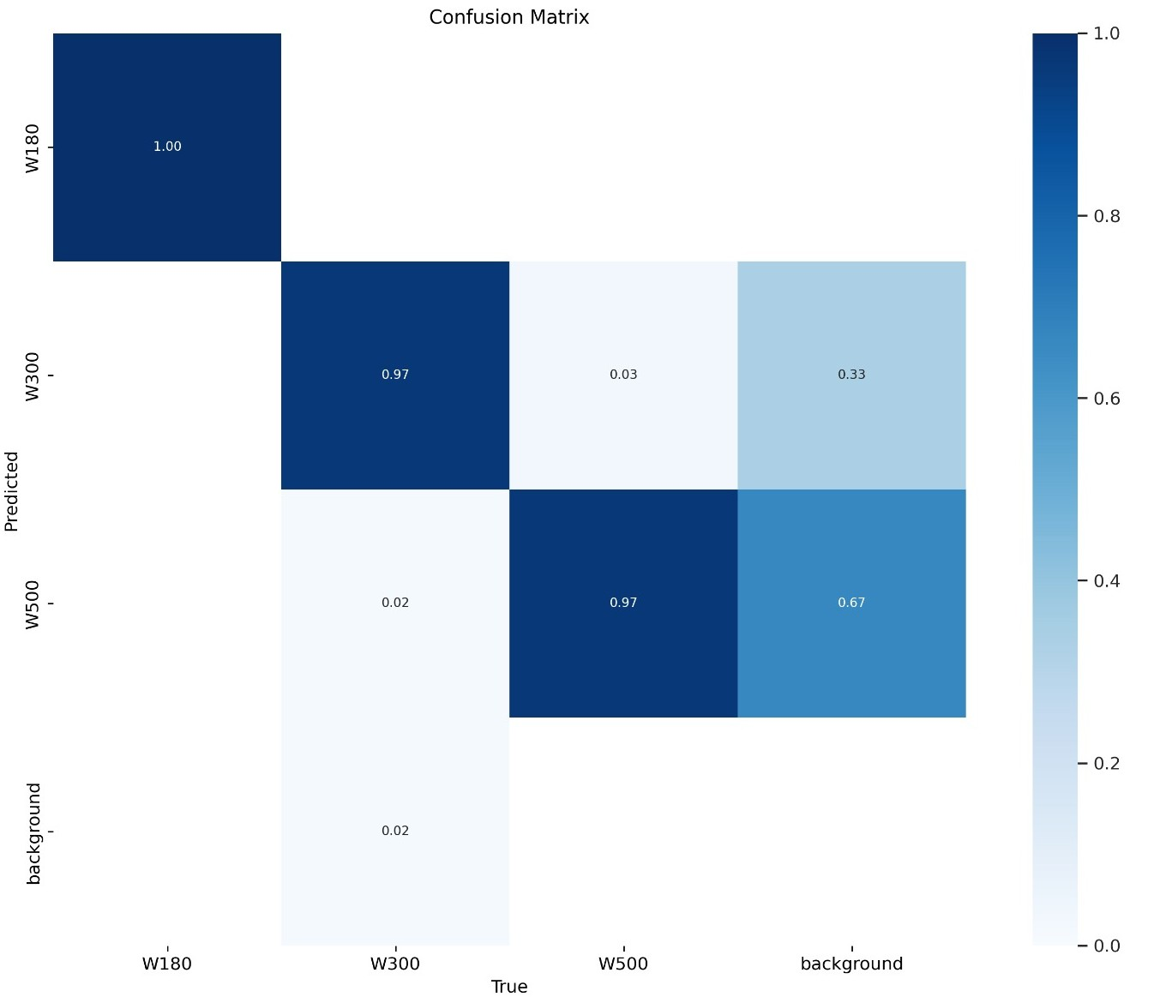
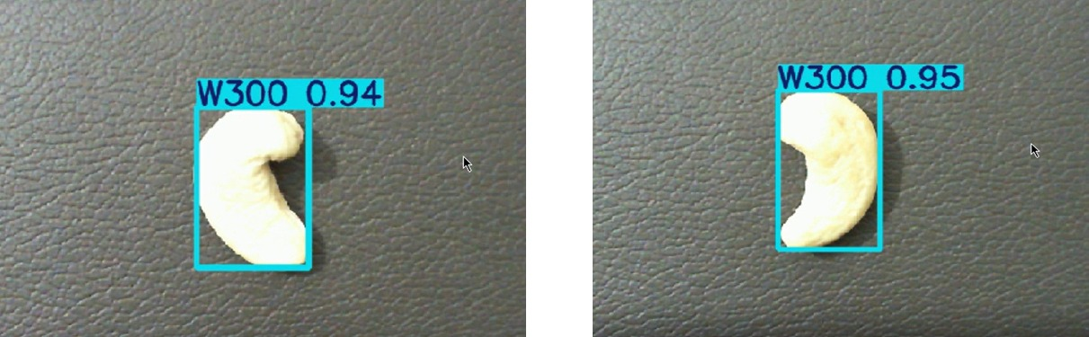
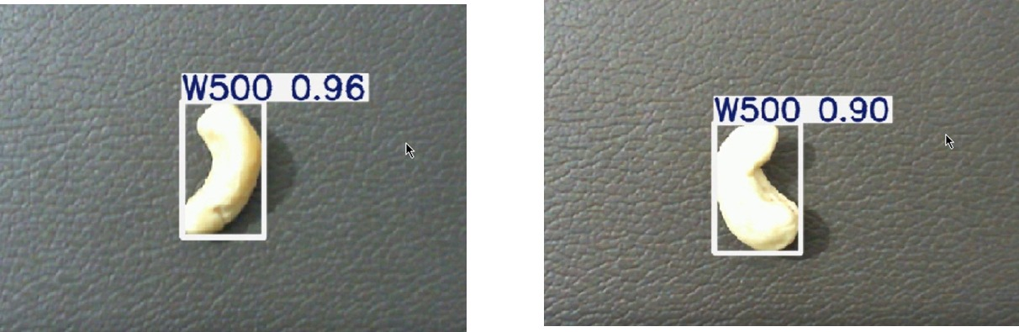
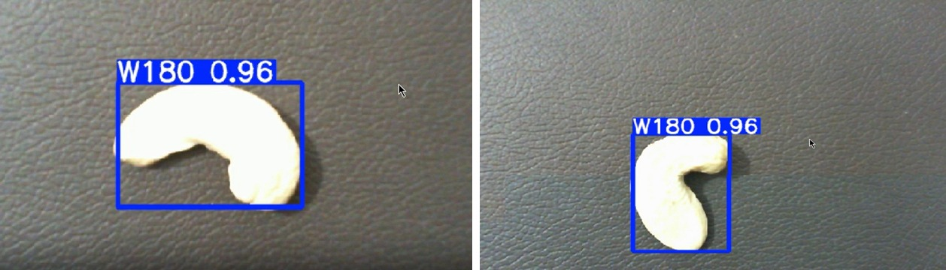
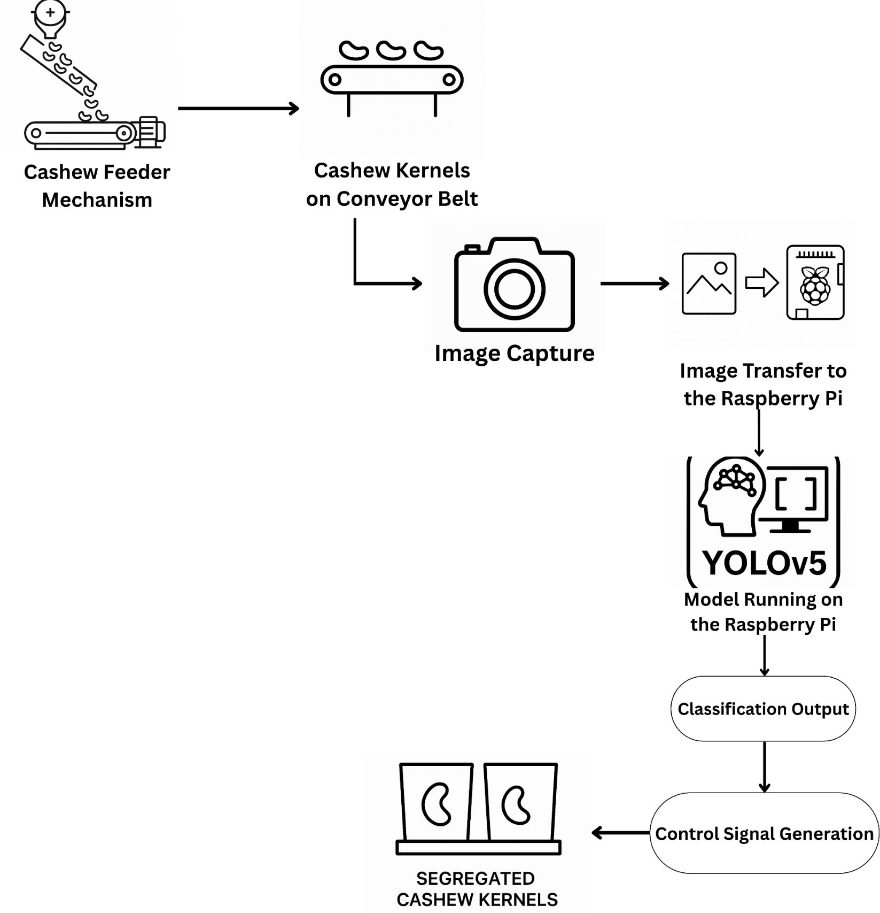


VI SEMESTER INTER DISCIPLINARY PROJECT
Go, change the world
Real Time Cashew Kernel Classification Using Deep Learning
Ravikant | Sagar T Nayak | Kiran H R | Manoj Kumar B V | Yogeesh A S
1RV23EC408 | 1RV23EC410 | 1RV23CS405 | 1RV23CS407 | 1RV23BT404
Abstract
Hardware/Software model
This project aims to replace the traditional, manual cashew kernel grading process with Deep Learning based, real-time classification and sorting system. By capturing high-resolution images under varied lighting and applying a trained YOLOv5s model, the system accurately identifies Two commercial grades of kernels: W180 and W500. Deployed on a Raspberry Pi with integrated hardware control via Arduino, it enables precise, automated sorting using motorized flaps. The approach enhances grading speed, accuracy, and consistency while reducing labor dependency and operational cost.
Problem Statement
The commercial value of cashew kernels depends heavily on accurate grading based on size, shape, and surface quality. However, traditional grading methods are manual, labor-intensive, inconsistent, and prone to human error and fatigue. There is a need for an automated, objective, and real-time system that can reliably classify and sort cashew kernels using computer vision and deep learning techniques.
Hardware Setup
Results
Objectives
Develop an image processing system to capture raw cashew kernel images and perform data preprocessing.
Design and implement algorithms for feature extraction, data analysis, and classification of kernel variations.
Apply DL techniques to accurately detect, classify, and grade defects in cashew Kernels
Integrate reliable hardware and software components for efficient, real-time testing and grading
Confusion Matrix
Classification Results
Methodology
Outcome
Cashew Feeder: Feeds Cashew kernels one by one onto the conveyor belt to avoid overlapping
Cashew Kernel on Conveyor belt: Transports the kernels under a fixed camera setup in a single line for consistent detection
Image Capture: Captures real time images of kernels using a top mounted webcam.
Image Transfer to Raspberry pi: Sends the captured frame to the raspberry pi for inference
Yolov5s inference and Sorting Control: The Raspberry Pi runs the YOLOv5 model to classify kernels in real time and sends corresponding control signals to the Arduino, which activates the sorting flaps based on the detected grade (W180 or W500).
The developed system successfully performs real-time classification and sorting of cashew kernels into commercial grades (W180,W500) using a YOLOv5 model deployed on a Raspberry Pi. With accurate detection and automated actuation through Arduino-controlled flaps, the system achieves over 93% classification accuracy and 94–96% physical sorting accuracy. This solution significantly improves grading speed, consistency, and labor efficiency, offering a scalable, low-cost alternative to traditional manual methods.
References
[[1] A. M. O. Arun, G. N. Aneesh, and A. Shyna, “Automated cashew kernel grading using machine vision,” in Proc. Int. Conf. Next Generation Intelligent Systems (ICNGIS), 2018, pp. 1–6. doi: 10.1109/ICNGIS.2016.7854063.
[2] A. Shyna and R. M. George, “Machine vision based real time cashew grading and sorting system using svm and back propagation neural network,” in Proc. Int. Conf. Circuits Power and Computing Technologies (ICCPCT), 2017, pp. 1–4. doi: 10.1109/ICCPCT.2017.8074385.
[3] A. Sivaranjani, S. Senthilrani, B. Ashokumar, and A. S. Murugan, “An improvised algorithm for computer vision based cashew grading system using deep cnn,” in Proc. IEEE Int. Conf. Current Trends in Advanced Computing (ICCTAC), 2019, pp. 1–6.
[4] S. N. Karnam, V. S. Vaddagallaiah, P. K. Rangnaik, A. Kumar, C. Kumar, and B. M. Vishwanath, “Precise cashew classification using machine learning,” Engi neering, Technology & Applied Science Research, vol. 14, no. 5, pp. 17414–17421, 2024. doi: 10.48084/etasr.8052.
[5] M. A. and P. N. Renjith, “Classification of durian fruits based on ripening with machine learning techniques,” in Proc. Int. Conf. Intelligent Sustainable Systems (ICISS), 2020, pp. 542–547.
[6] V. Gautam, R. G. Tiwari, A. Misra, D. Witarsyah, N. K. Trivedi, and A. K. Jain, “Dry fruit classification using deep convolutional neural network trained with trans fer learning,” in Proc. Int. Conf. Advancement in Data Science, E-learning and In formation System (ICADEIS), 2023, pp. 1–6. doi: 10.1109/ICADEIS58666.2023. 10270982.
Signature
Dr. Veena Devi S V
Associate Professor, Dept. of ECE
Notes:
1

